Slide 1
FUEL SHIELD SYSTEM
THE TECH INNOVATORS
A passionate group of innovators aiming to solve real-world transportation challenges
Team I'd
TEM3080

Slide 2
PROBLEM
Misfuelling causes engine damage, costly repairs, and inefficiencies.
SOLUTION
The Fuel Shield System automatically detects and prevents incorrect fuel dispensing using an RFID-based system.

Slide 3
TECHNICAL OVERVIEW
Key Technologies and Tools:
1. RFID Tags and Reader-Identifies vehicle fuel type.
2. Arduino Controller-Manages fuel type checks and dispensing control.
3. LCD Display- Displays system messages and alerts.
4. Buzzer Audio Alert-Notifies users of fuel mismatches.
5. Dispensing Control- Prevents incorrect fuel flow.

Slide 4
BUSINESS POTENTIAL
Market Need: Growing need for
automated systems to avoid engine damages and reduce operational costs.
Target Users: Fuel stations,
vehicle owners, fleet management companies.
Feasibility: Technically achievable
and scalable with low implementation costs.

Slide 5
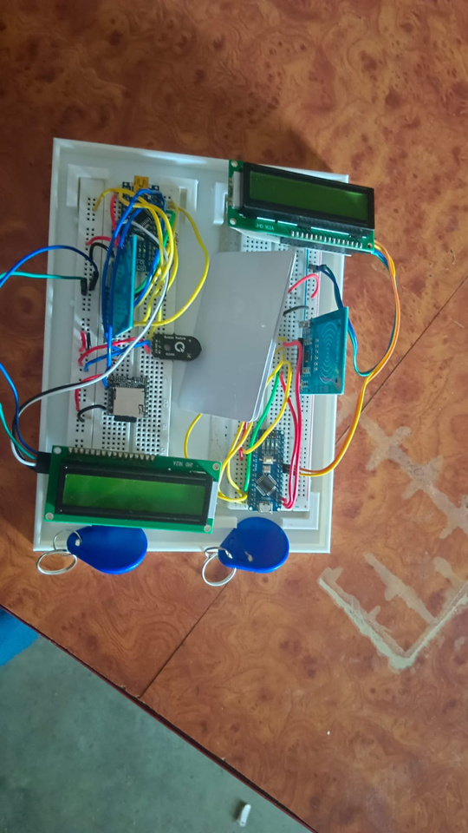
DEMO OR VISUALS
Prototype: Visual representation of
the RFID system setup (RFID reader, Arduino, display, and nozzle control).
Demo:A quick walkthrough of fuel type detection and prevention workflow.

Slide 6
IMPACT AND CONCLUSION
IMPACT
Reduces engine repair costs.
Enhances fuel station safety and efficiency.
Promotes customer trust and loyalty.
CONCLUSION
The Fuel Shield System is an innovative, feasible solution with strong market potential to prevent misfuelling and save significant financial and environmental resources.

Slide 7
Thank you!

